Slide 1
VI

Slide 2
Auto Receptionist

Slide 3


Incoming Call Solution – Auto Receptionist
One person attending too many calls
Missed Calls vs Free man
Missing Follow-up
Efficiently Handle with Cloud IVR
Potential Segments
SME Retail
Hospital Automobile Dealers
Real Estate Hotel Chain
Sales
732000xxxx
IVR
Customer
Call Processing
Service
Support
Sometimes businesses will have a Tollfree Number configured for customers to call
In such cases Data Assist team configures all calls coming to the TFN to land on the IVR number

Slide 4
Incoming Call Solution – Auto Receptionist
Vi Cloud Telephony platform offers Auto Receptionist which is a voice-based IVR (Interactive Voice Response) solution, that addresses queries on the go and routes calls to the necessary departments or nominated agents. Incoming callers are presented with a greeting and options to choose from (press 1 for sales, etc.) and then routed to the selection they make. Different options can be made available depending on the schedule (Business Hours, After Hours and Holiday).
Points to remember in Auto Receptionist:
DTMF: Dual tone multi-frequency (DTMF) is the sounds or tones generated by a telephone when the numbers are pressed. These tones are transmitted with the voice channel. DTMF is used to control automated equipment and signal user intent, such as the number they wish to dial.
Example: If we make a call to a customer care then we listen the automated sound as “Press 1 for Hindi, press 2 for English. This Press 1, Press 2 are DTMF.
In auto receptionist after DTMF customer’s call will be routed to the agents.
Agent’s number will not be visible to customer. Customer will be able to see only IVR number in which number he has called.
In auto receptionist service if customer’s call connected to the agent then there will be recording in the portal.
OG duration: The conversation time between the agent and the customer. It will be in seconds.

Slide 5
Incoming Call Solution – Auto Receptionist
Call Routing Process in Auto Receptionist:
Agents will receive the calls in 3 types of dialing:
Parallel Dialing: Call will be routed to every agent at a time. If one agent picks up the call, the ring will stop for others.
Round Robing: Call will be connected to the agent one by one. Ex: If 4 agents are there then 1st call will be routed to the 1st agent. 2nd call will be routed to 2nd agent.
Sequential Routing: Here every call will be connecting to the 1st agent first. If 1st agent is busy then it will be transferred to 2nd agent. Call will stay with the first agent for 20 second.
Sticky Agent in Auto Receptionist:
Sticky Agent: If first time call connects to 1st agent then if the customer calls 2nd time and if we enable sticky agent then call will be connected to the 1st agent only so that customer does not need to explain all details to the customer.

Slide 6


Auto receptionist : Optimize operations and route queries to right department
Need for Auto receptionist :
Enterprises would like to ensure that various business queries are optimized by sharing correct information on the fly or routing calls to correct departments ensuring better CXX and cost savings, some of the business challenges that could be addressed by auto receptionist are listed below :
Information about Products & Services.
Information about new Offers & Campaigns.
Information about Query Request & Complaints.
Cloud telephony platform offers voice based Auto receptionist solution which addresses queries on the fly and helps route calls to correct departments or nominated agents.
Benefits of Lead management solution:
Business process automation.
Better CXX
Track and Never miss a query & Brand Image Boost.

Slide 7

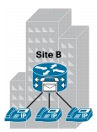


Auto receptionist : Optimize operations and route queries to right department
Step 1 :
User / Prospect calls to defined IVR number
Step 2 :
Detailed IVR flow is prompted to caller.
The caller can navigate through IVR flow and choose correct query by entering DTMF.
Information related to selected query is prompted back to caller.
If required the caller is patched to concerned department for query resolution.
Step 3:
Call is patched to nominated agent of the concerned department
VIL Cloud Telephony platform
Caller
Agents
Caller
Step 4:
Admin can log in to portal to access the details of call status (queries)
Caller
Step 5:
Ack. SMS is sent back to prospects with relevant information.

Slide 8
Tab Details
TAB NAME | DETAILS
TOTAL CALLS | Total calls agents receive.
UNIQUE CALLS | Agents receive calls from unique number.
PATCHED CALLS | Agent answered these calls.
MISSED CALLS | Calls which agent did not receive.

Slide 9
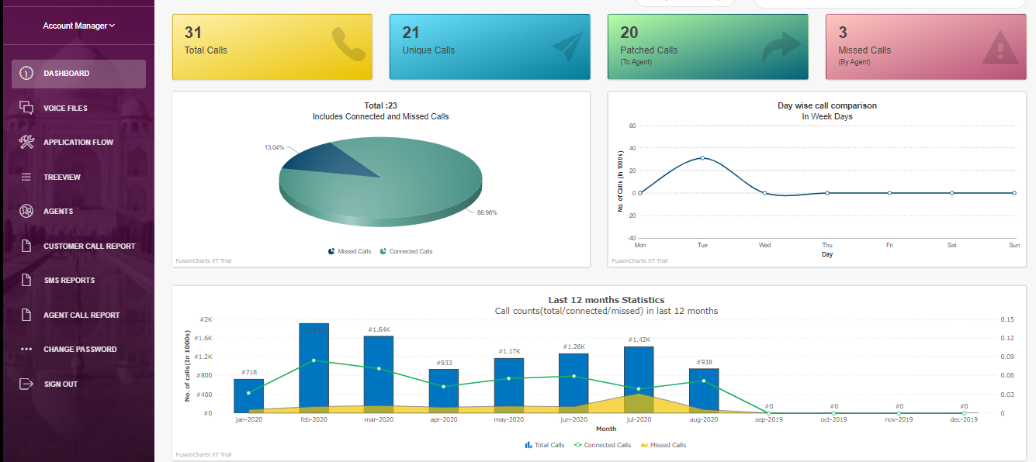
Auto receptionist – Dashboard

Slide 10
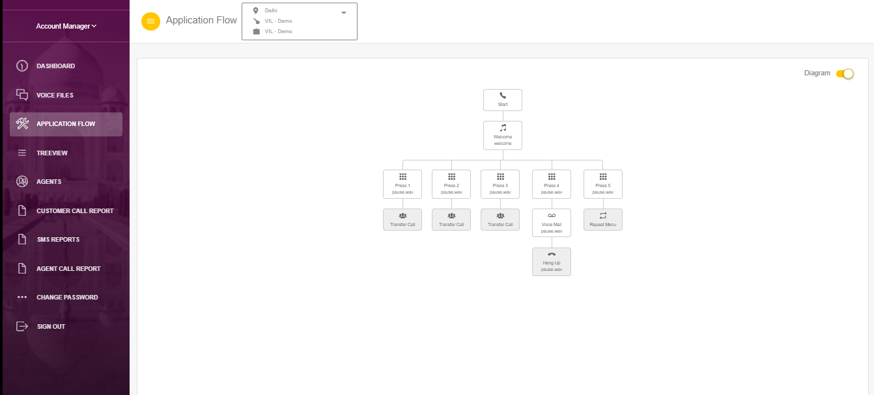
Auto receptionist – Application Flow

Slide 11
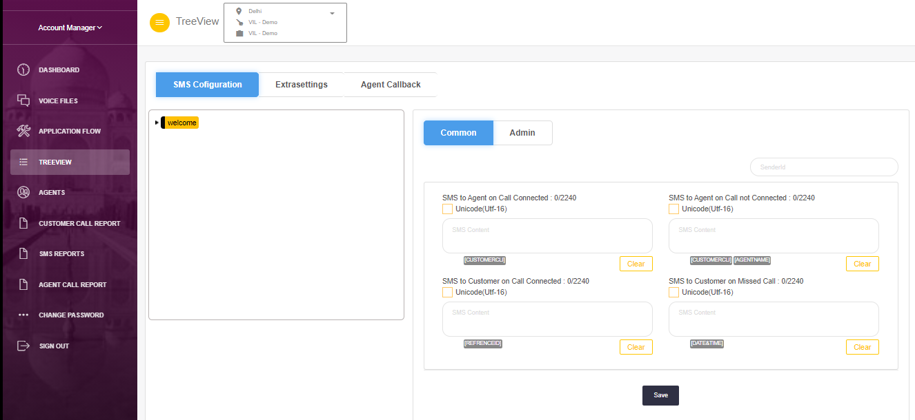
Auto receptionist – SMS Configuration

Slide 12
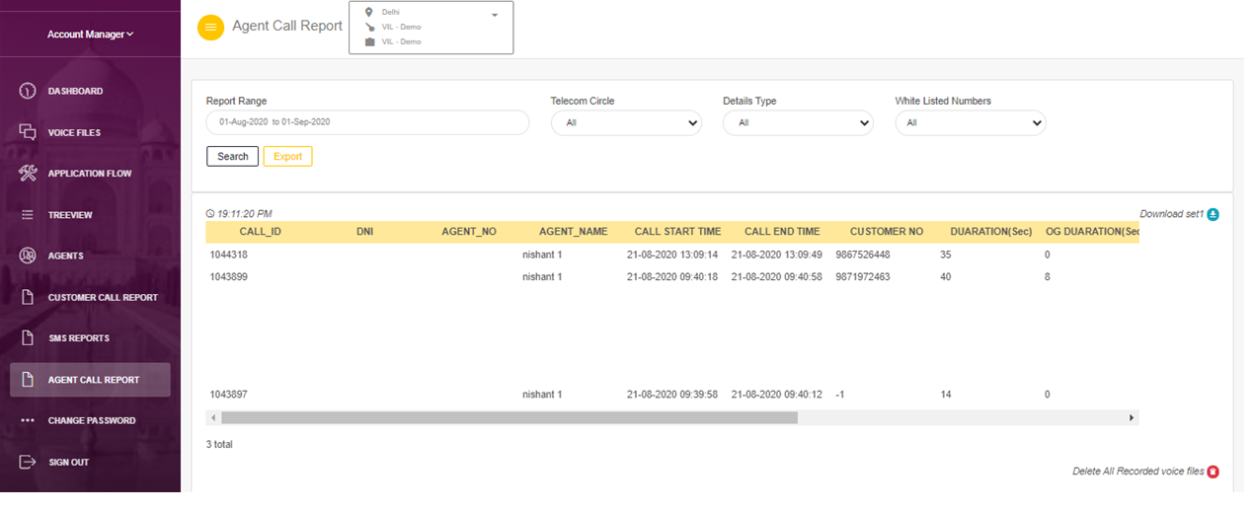
Auto receptionist – Reports

Slide 13
Thank You

